Slide 1

Presentation title second line if required
Sub-title
Second line if required

Slide 2
Title for text slide 32 point with 1 line spacing after
Sub-title 24 point with 1 line spacing after
Main copy size 14 point
Line spacing 1.2 for all text
Bullet 1 use standard bullet
Bullet 2 use for secondary bullet

Slide 3
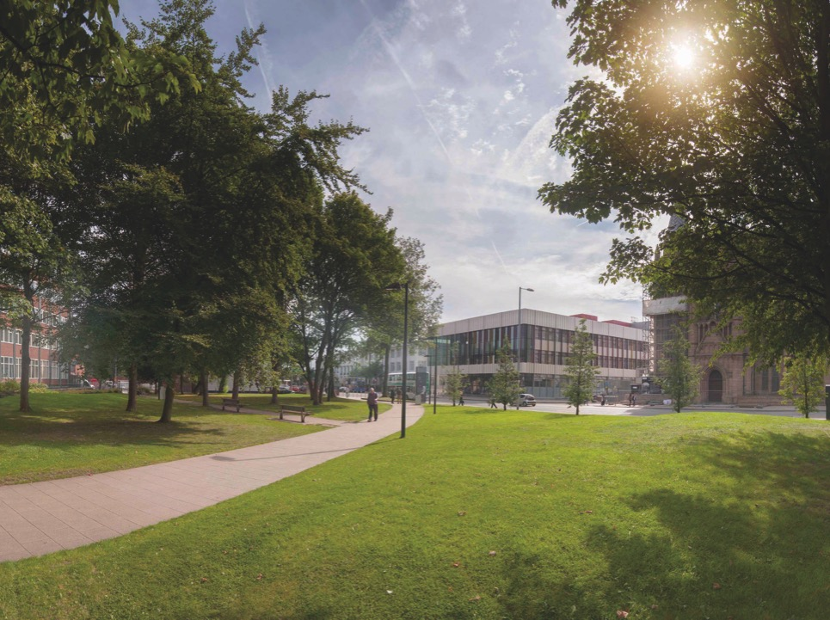
Ideally images…
Should fill the screen
With minimum or no text
If there is any text it should be against a solid background colour

Slide 4


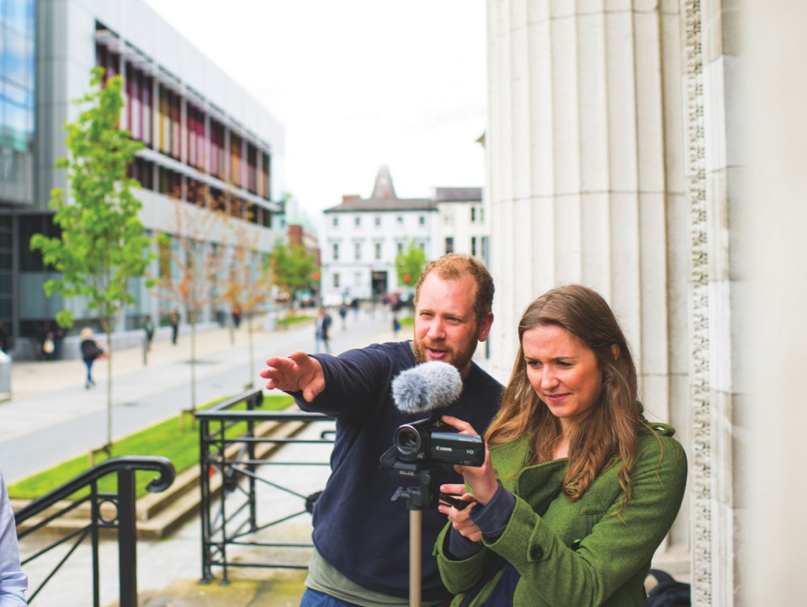
Preferably images should…
Be uniform in size
Complement the content
Not impact on the copy area
Include descriptions (right click on image, format picture, Alt-text to include a description)

Slide 6


